Slide 1
Singelton

Slide 2
What is singelton class
A singelton class is a class that is instantiated exactly once.
It is done by making constructor private
3 ways to refer that one instance, :
first by field that should be declared as final( this might not involve lazy loading)
second by a method getInstance ( this can give us lazy loading)
enum way(but cant be used if our singelton extends a superclass)
The public field approach is preferable.
Enum way is best if we do not want to use

Slide 3
why public field is preffered
Advantages of the public field approach:
Simplicity: It's simple and concise, making it easy to implement and understand.
Eager initialization: The singleton instance is created when the class is loaded, avoiding any potential race conditions in multi-threaded environments.
Direct access: The INSTANCE field is accessible directly, making it convenient for usage across the application without the need for a getter method.
However, this approach does have some trade-offs:
Lack of lazy loading: The singleton instance is created eagerly during class loading, which might not be suitable for scenarios where lazy loading is preferred to defer instantiation until needed.
Potential reflection issues: As mentioned previously, this approach might be vulnerable to reflection attacks if someone tries to use reflection to access and modify the supposedly immutable field.

Slide 4
when factory way is prefeered
A advantage
is that you can write a generic singleton factory if your application requires it

Slide 5
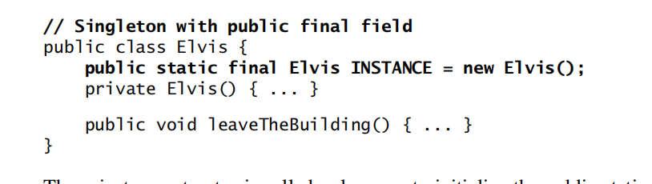
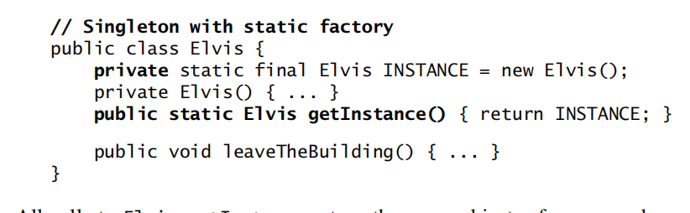
example

Slide 6
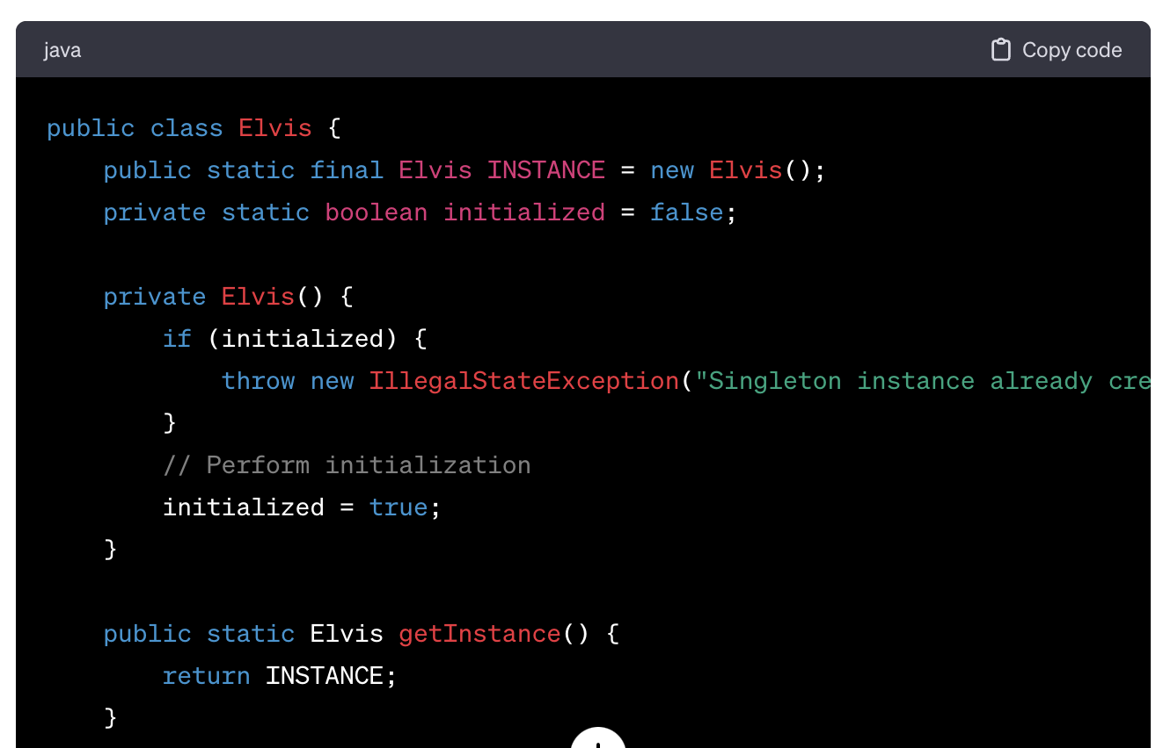
There is still a way by which we can still create instance (by using reflection)
So to avoid reflection from creating another instance , we should have a check as below

Slide 7
De-Serialization issues
Deserialization: Deserialization is the process of reconstructing an object from its serialized state. This process involves reading the byte stream and creating an object from it using ObjectInputStream.
But if singelton is serializzed, then deserialiazation may cause to create a second instance.
make all fields transient.
In Java, when a field in a class is marked as transient, it means that the field should not be included in the object's serialized form when the object is converted into a byte stream during serialization.
The readResolve() method is a special callback method in Java that is used during the deserialization process of an object. It allows the class to provide its custom logic to control what object is returned after the deserialization is complete.

Slide 8
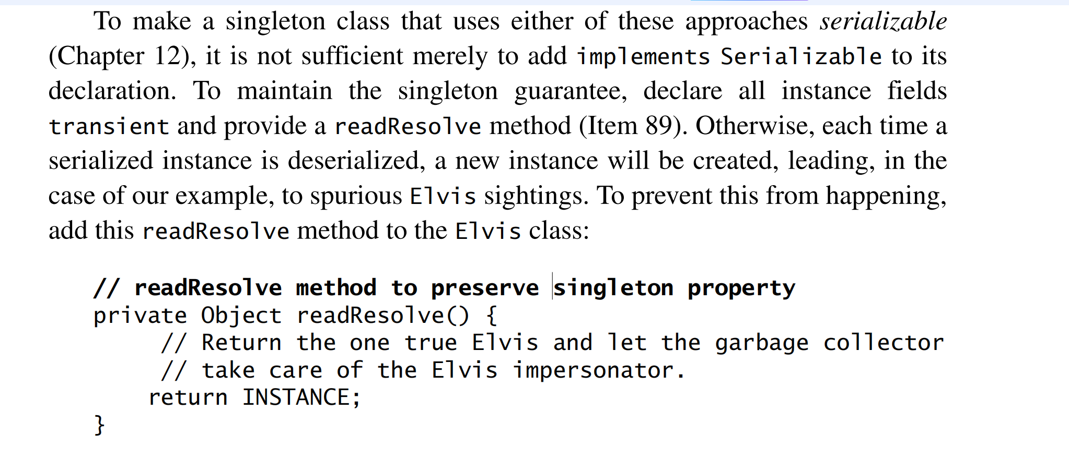
Readresolve Method overriding is required

Slide 9
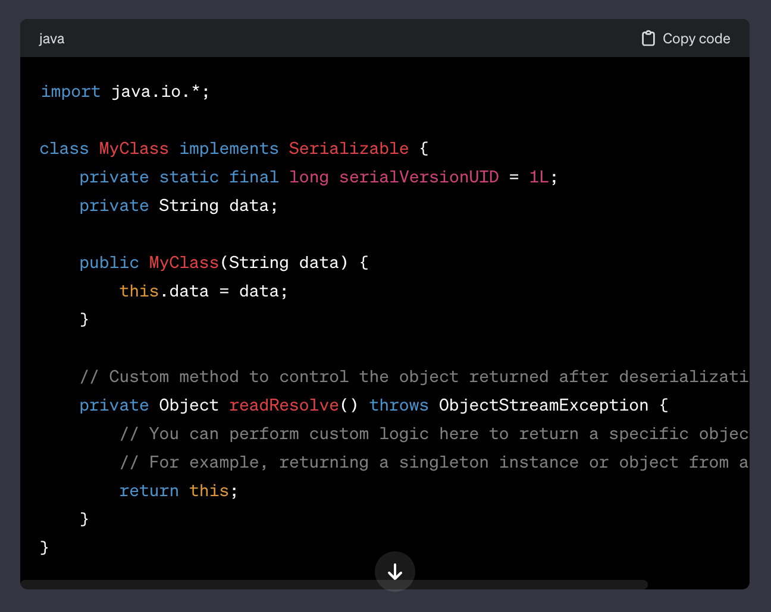
ReadResolve method

Slide 10
Why to create a singelton class?
Resource Sharing:
Global Access
Memory Efficiency:
Drawbacks of using singleton patterns:
Global State:=tight coupling
Concurrency Challenges:
Dependency Injection vs. Singletons: In modern software design, dependency injection is often favored over singletons as it allows better control of object creation, improves testability, and reduces tight coupling.

Slide 11
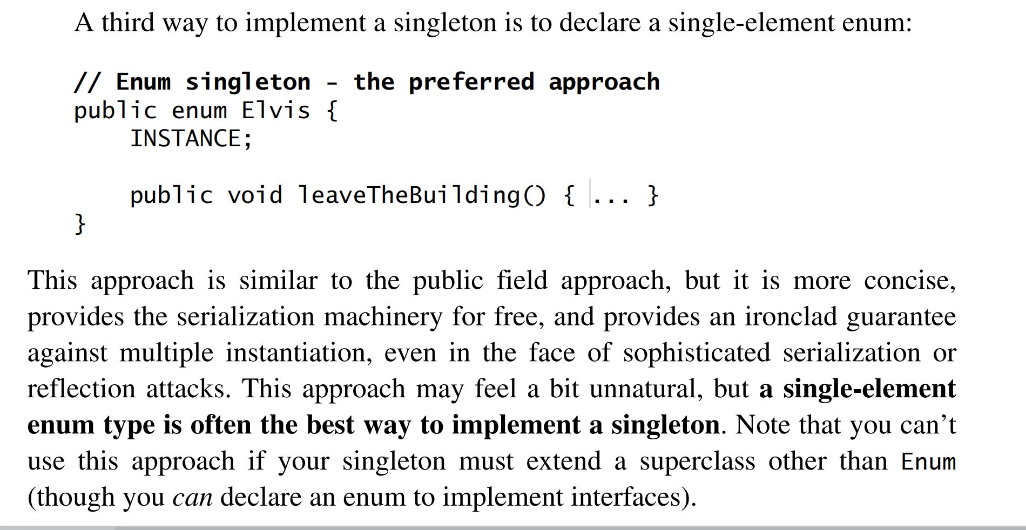
3: enum way

